Slide 1
Crime Data Analysis
Name: Nidhi Atkare
PRN: 22070521043
SEC: A SEM: 7th
Mini Project | Data Science
Dataset: NCRB Crime Dataset

Slide 2
Project Objective:
Goals of the Project:
  Analyze crime patterns using NCRB dataset
  Clean and preprocess raw data
  Perform Exploratory Data Analysis (EDA)
  Build ML models: Regression, Classification, Clustering
  Develop an interactive Streamlit Dashboard

Slide 3
Dataset Description:
Dataset Information:
  Source: NCRB (National Crime Records Bureau)
  Crime statistics across different categories
  Columns include: Cases Reported, Chargesheeted, Pending cases etc.

Slide 4
Data Cleaning Steps:
Performed:
  Loaded dataset using Pandas
  Removed duplicates
  Handled missing values
  Converted text to numeric values
  Saved cleaned file

Slide 5
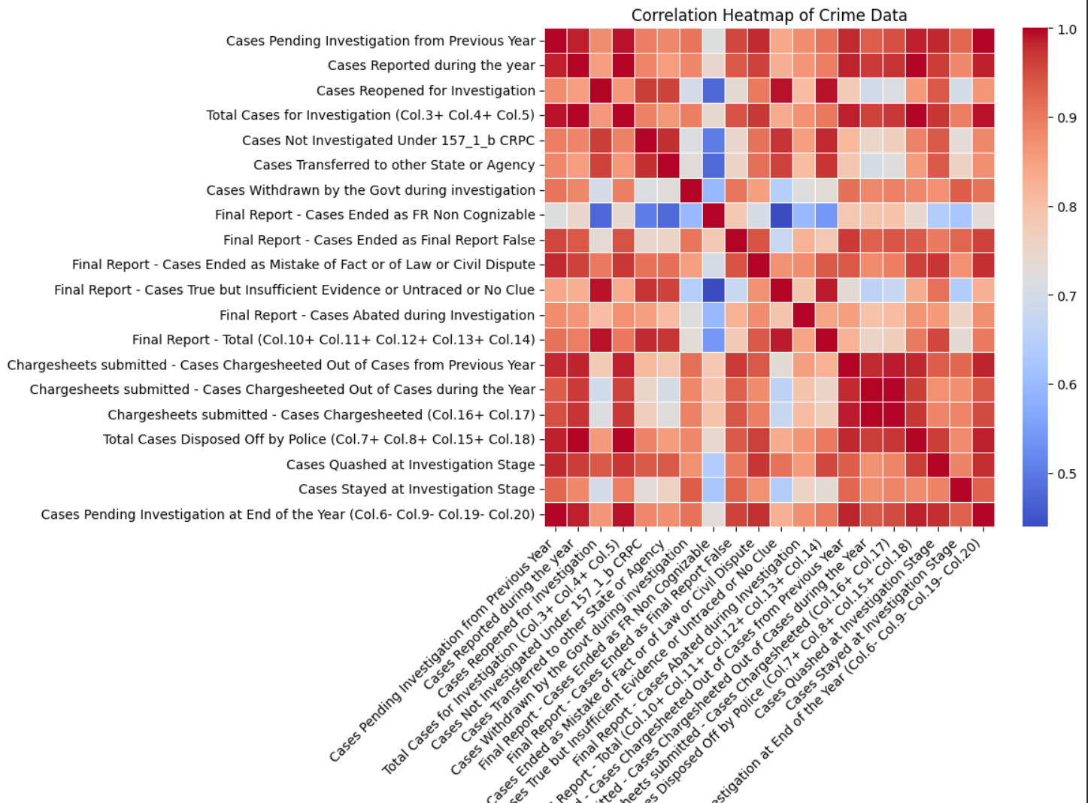
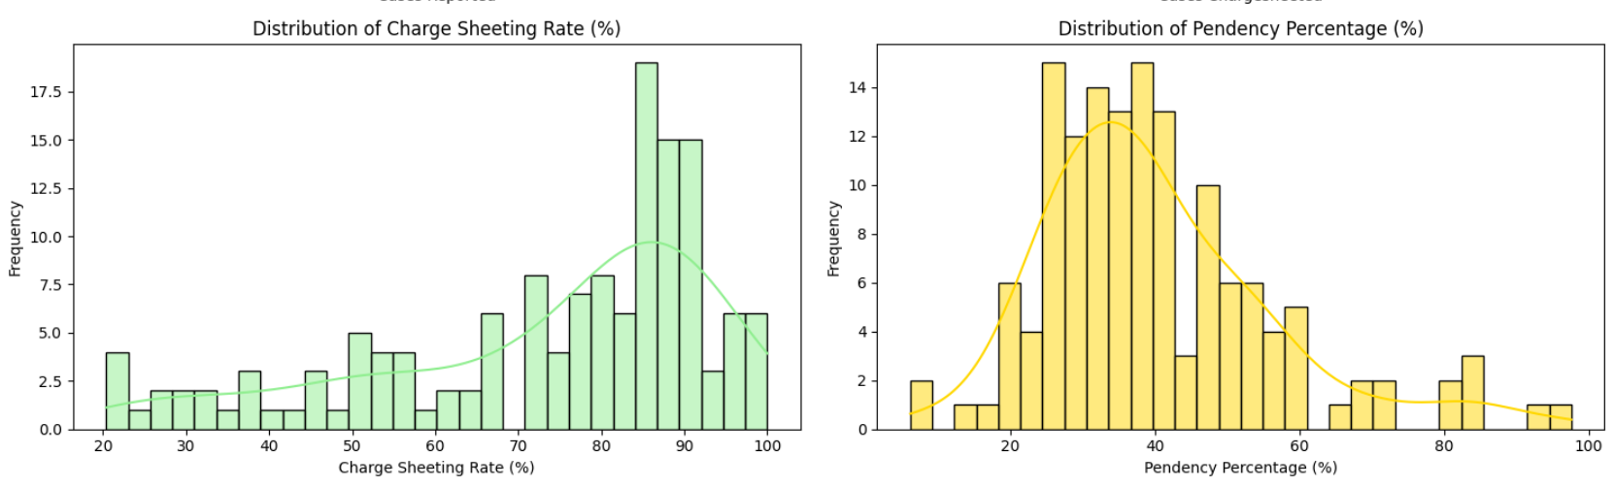
Exploratory Data Analysis:
EDA Included:
  Distribution plots of crime metrics
  Correlation heatmap
  Bar graph of top crime categories
  Pie chart of crime proportions
  Pair plots for numeric features

Slide 6
Feature Engineering:
Engineered Features:
  Total crime column
  Crime encoded column
  Scaled key features
  Created Crime_Level label

Slide 7
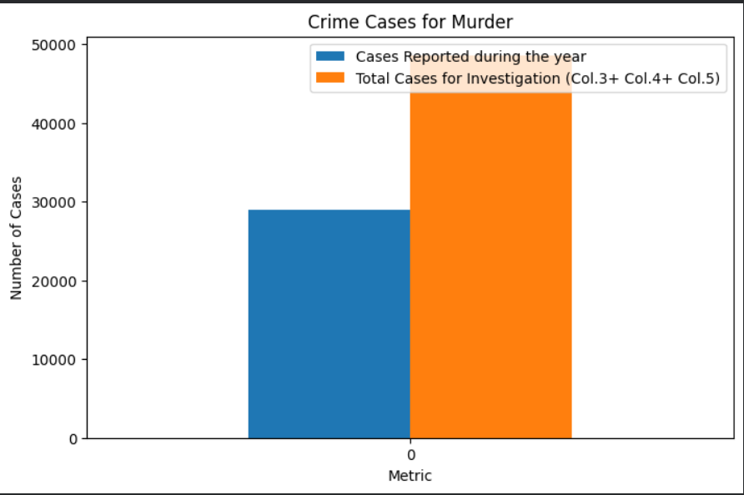
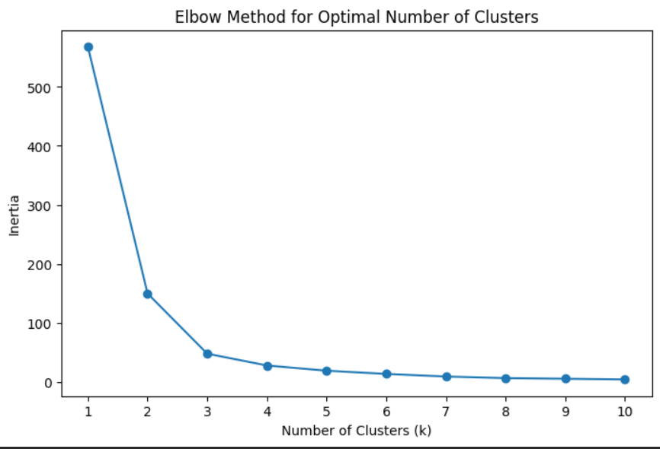
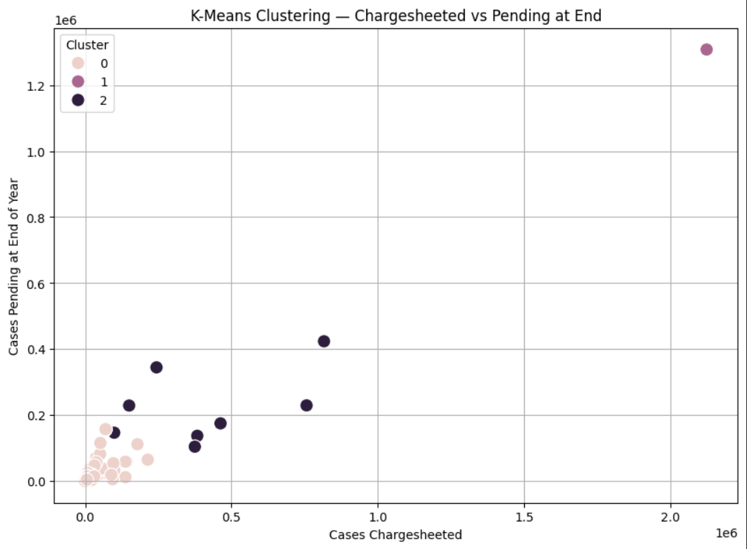
Machine Learning Models:
Models Applied:
  Linear Regression
  Logistic Regression
  Random Forest Classifier
  K-Means Clustering
  DBSCAN Clustering

Slide 8
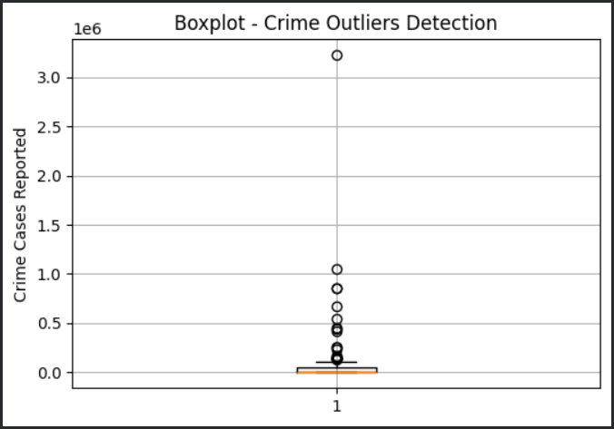
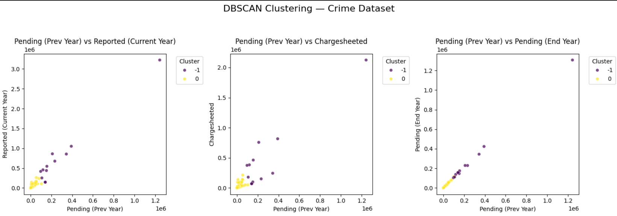
Outlier Detection:
Method Used: IQR
  Detected unusual high/low crime values
  Visualized using box plot

Slide 9
Streamlit Dashboard Features:
Dashboard Features:
  Dataset preview
  Statistical summary
  Correlation heatmap
  Interactive charts
  CSV download option

Slide 10
Conclusion:
Key Takeaways:
  Crime distribution patterns identified
  Classification & clustering revealed trends
  Dashboard enhances visualization & usability
  Useful for crime monitoring & planning

